Slide 1
Fish Age Determination
Some of the Basics

Slide 2
A bit of history:
340 BC – Aristotle speculated you could deterthe age of fish from the size and hardness of their scales
1667 – Hooke mentions concentric circles on fish scales
1672 – Leeuwenhook speculated that a new scale was created each year and fused with previous scales
1859 – Bell reported that fish age could be determined by counting rings on scales
1898 – Hoffbauer examined captive raised carp and studied the seasonal pattern of scale structure
And we are off to the races!

Slide 3
Structures used to age fish
Scales
Otoliths
Vertebrae
Opercula
Fin Rays
Spines

Slide 4
It’s JUST Counting Rings! Right?

Slide 5
Important things to consider
Age Validation(accuracy):
Release and recapture of marked known aged fish
Bomb Radiocarbon
Mark-Recapture of chemically tagged fish
Radiochemical dating
Age structures sampled from discrete age modes
Marginal Increment Analysis
Captive rearing

Slide 6
Ageing Precision
Defined as the reproducibility of repeated measurements
Two frequently used metrics
Average Percent Error - APE
Coefficient of Variation - CV

Slide 7
Quality Control
Preparation of Reference Collection
A collection of prepared ageing structures, of known or concensus-derived ages
Quality Control Monitoring
Periodic testing of agers against a subset of the reference collection

Slide 8
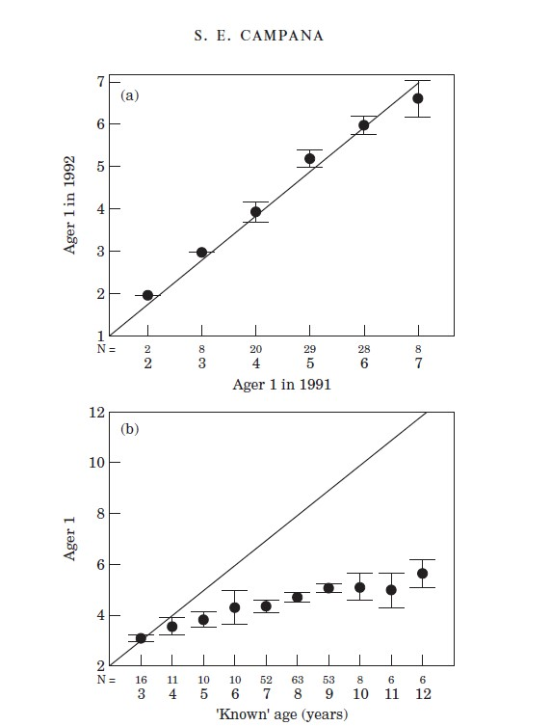
Quality Control
From Campana 2001

Slide 9
Some of my workshop goals:
Create networking opportunities for staff involved with Ageing Fish
Have Agers and researchers / stock assessment staff involved in the same conversation so that they can discuss concerns and issues
Work towards an environment where staff wish they also had the chance to age fish!

